Slide 1


Cancer Common Model: Formalize the Conceptual Model with LLM Assistance
Stefano Lotti, FHL7
OSA Co-Chair
HL7 Italy Chair
2025 May HL7 Working Group Meeting & Connectaton Madrid, Spain

Slide 2
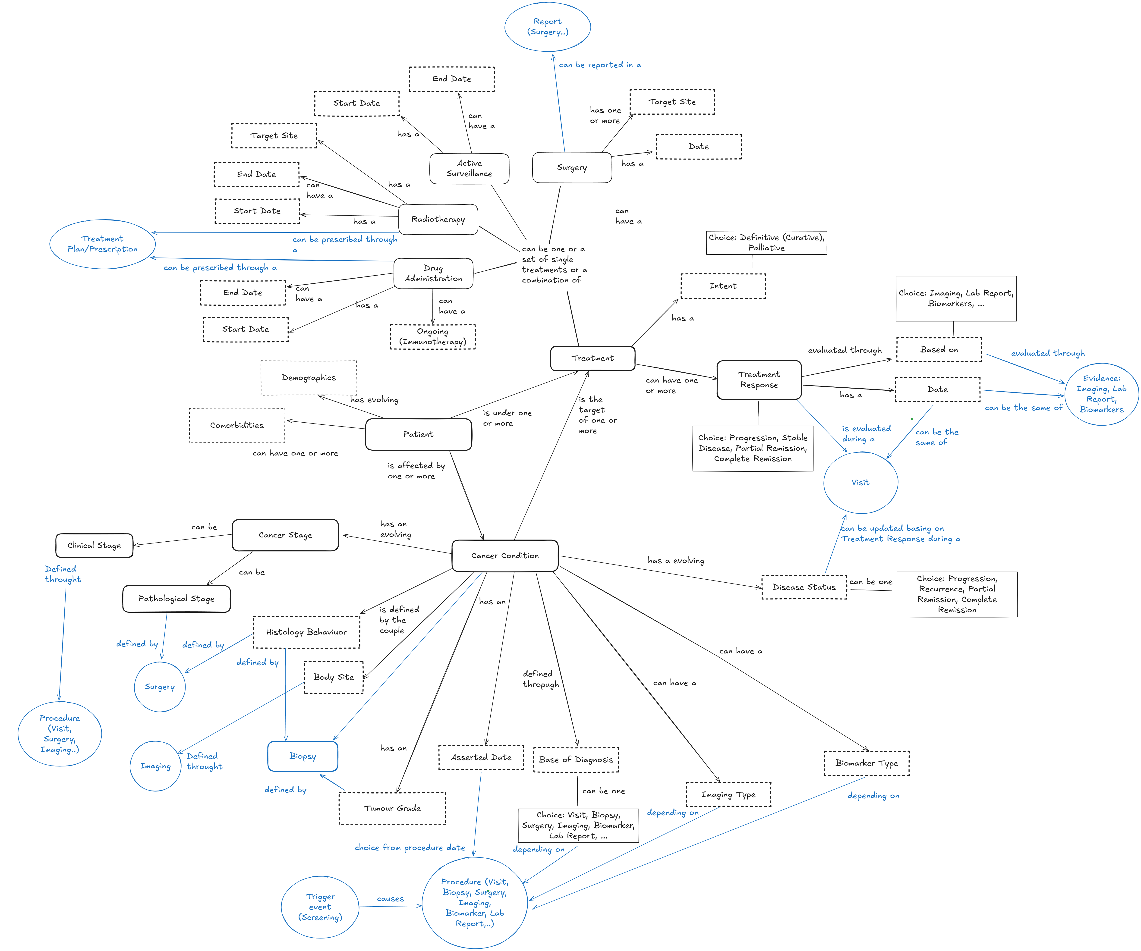
Formalizing the Cancer Common Concept Model
A next step for the model should involve organizing it into a formal format that natively includes the glossary.
This serves as a resource for consolidation and integration with the HL7 tool.
Additionally, a formal model can be computable (e.g. for FHIR mapping suggestions).
In this ongoing work, currently at an early stage, we employ formal languages such as OWL2 and UML alongside LLM to formalize and interrogate and map the model.

Slide 3
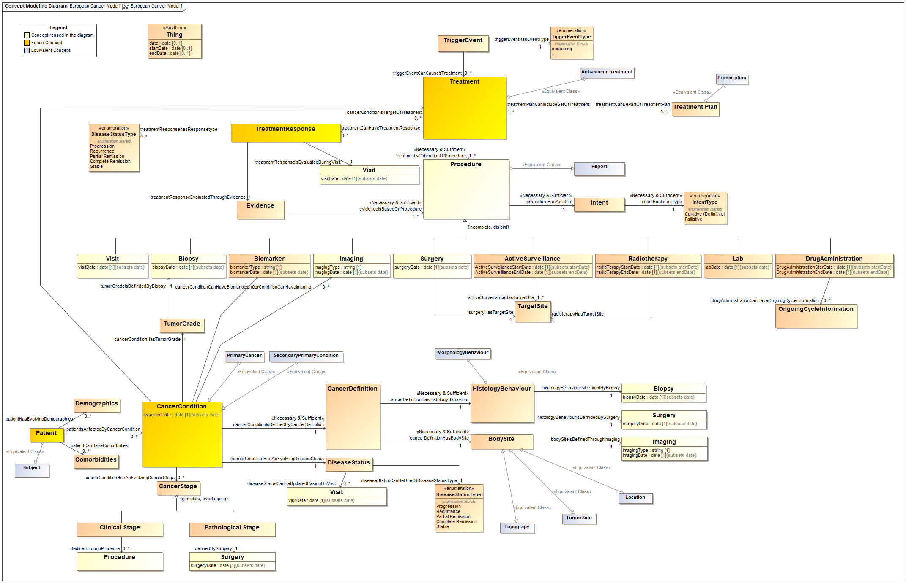

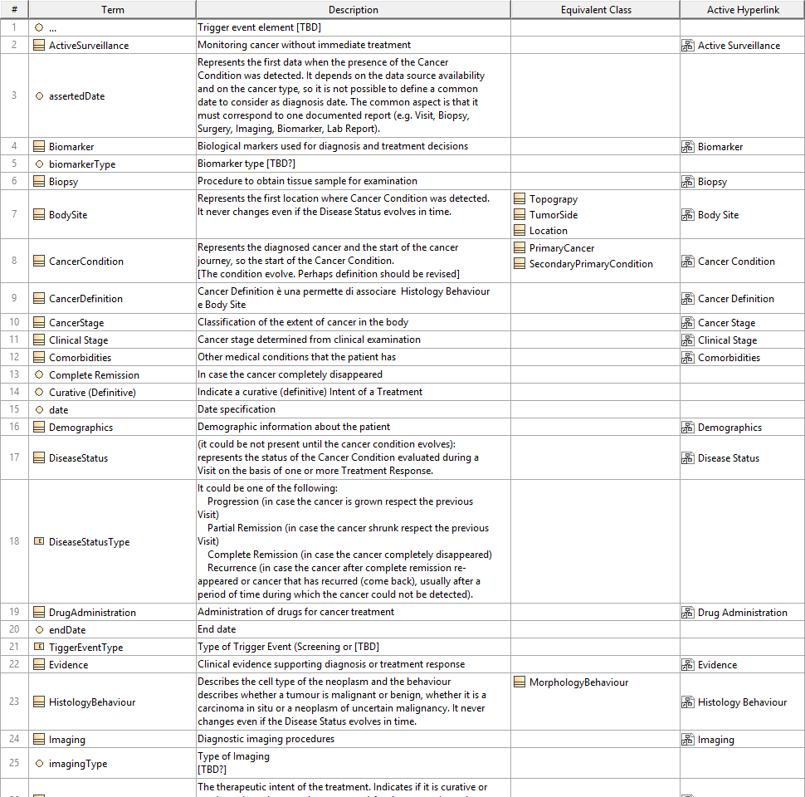

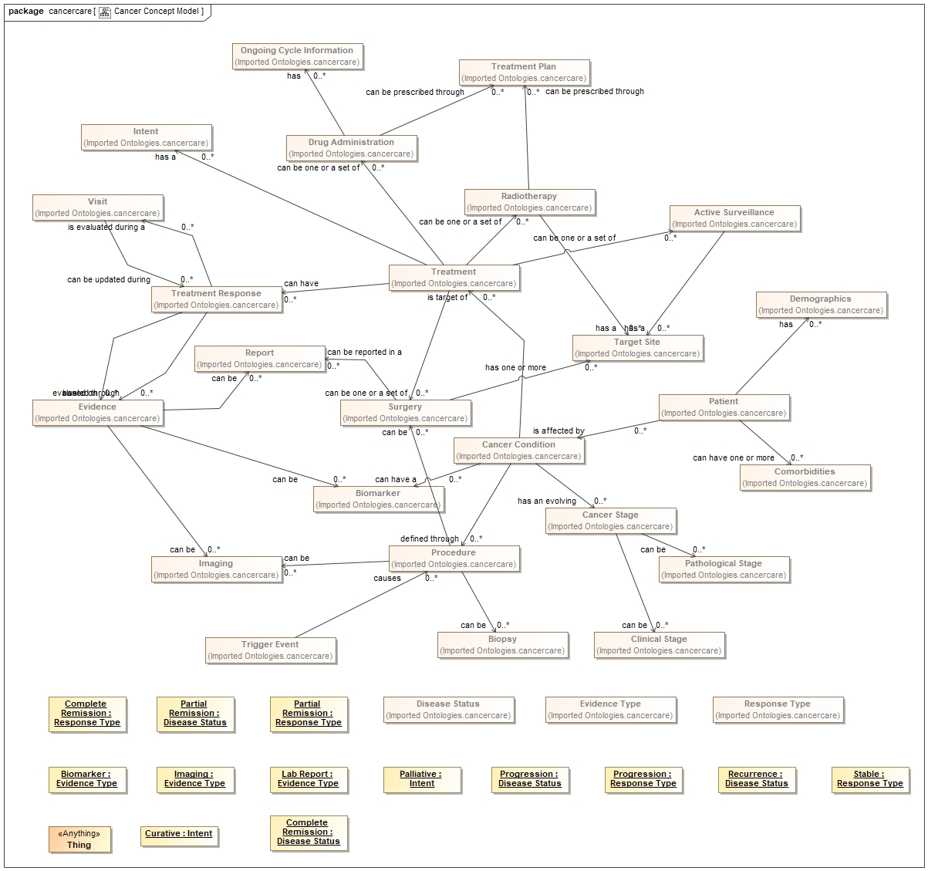
Process steps 1/2
The model's image serves as the input for an LLM (Claude 3.7 Sonnet) to convert the model into an OWL2 Ontology.
The OWL2 was then imported into a UML tool (3DS MagicDraw with Concept Model plugin) for further review and improvement.
Initial concept model
Prompt and LLM Elaboration
Revised Model + Glossary
Draft OWL2 model Generated (with a glossary)
66 entries (merge the generated glossary with the glossary available on the Confluence page)
OWL2 model import in UML tool with owl capability
(3DS MagicDraw 2024x)

Slide 4



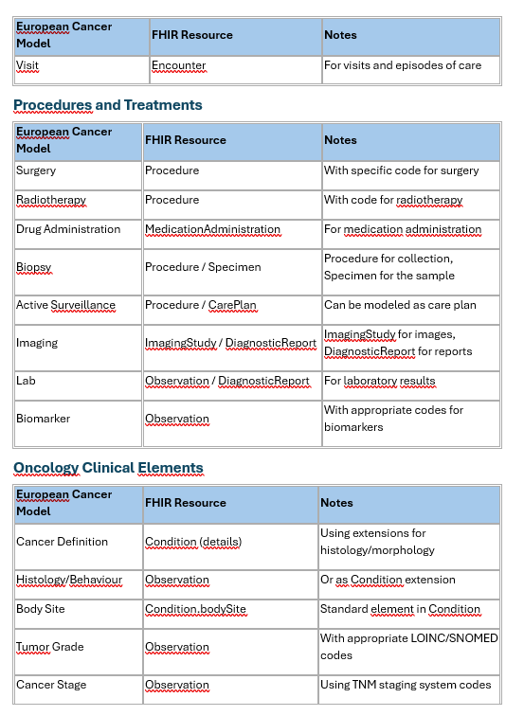
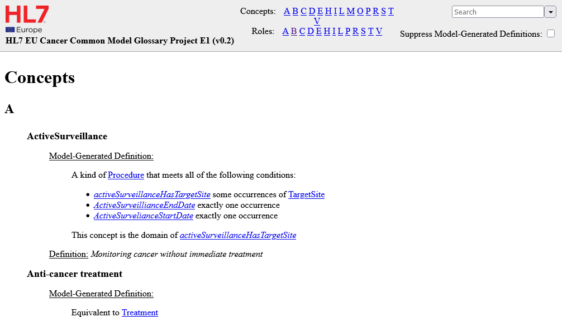
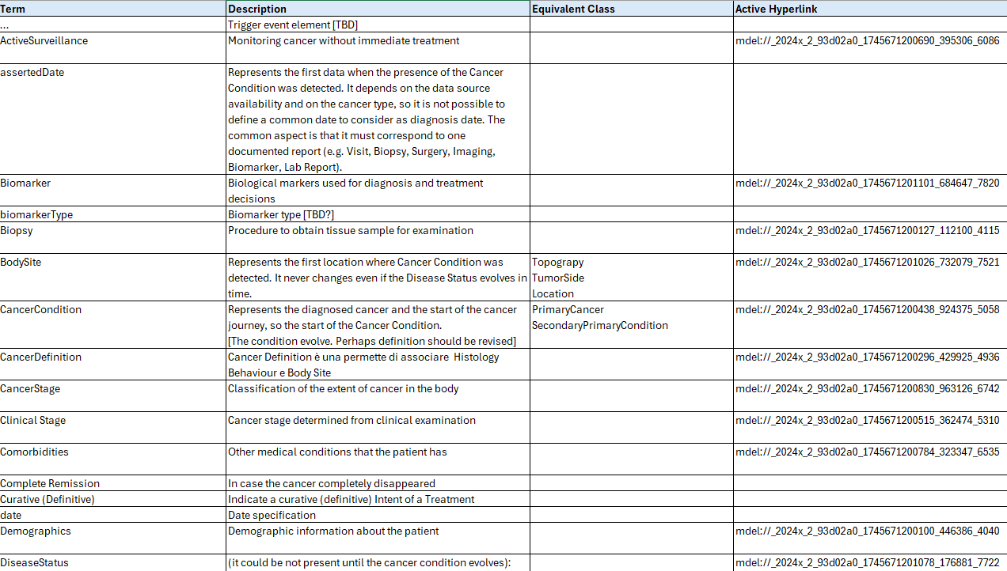
Process steps 2/2
Program generation to transform OWL2 in PlantUML file
The new model produces:
An updated OWL2 Ontology
A web-based Glossary
An Excel glossary
The revised OWL2 model, along with a generated Python script, creates the Plant UML file.
Revised Model + Glossary
New (Revised) Ontology
File
Tools
Prompt for
Mapping
Ontology with
FHIR Resource and Profiles
Mapping Documentation (Experimental draft)
Web glossary
Excel glossary
(sincronized)

Slide 5
Conclusion
The process was completed in two half-day sessions, and the resulting artifacts (prompt and program) are reusable.
The use of formal models with LLM enhance the robustness, aiding in the identification of potential ambiguities and ensuring consistency between the model and the glossary.
The final PlantUML file is compatible with HL7 tooling.
GitHub: https://github.com/slotti64/HL7-EU-Common-cancer-concept-model/tree/main

Slide 6
Next Step
Ensure alignment with the latest version of the model
Verify the derived ontology
Verify/revise the experimental FHIR mapping
Check the alignment with the FHIR RDF Ontology
…

